Slide 1

WELCOME
CADETS

Slide 2
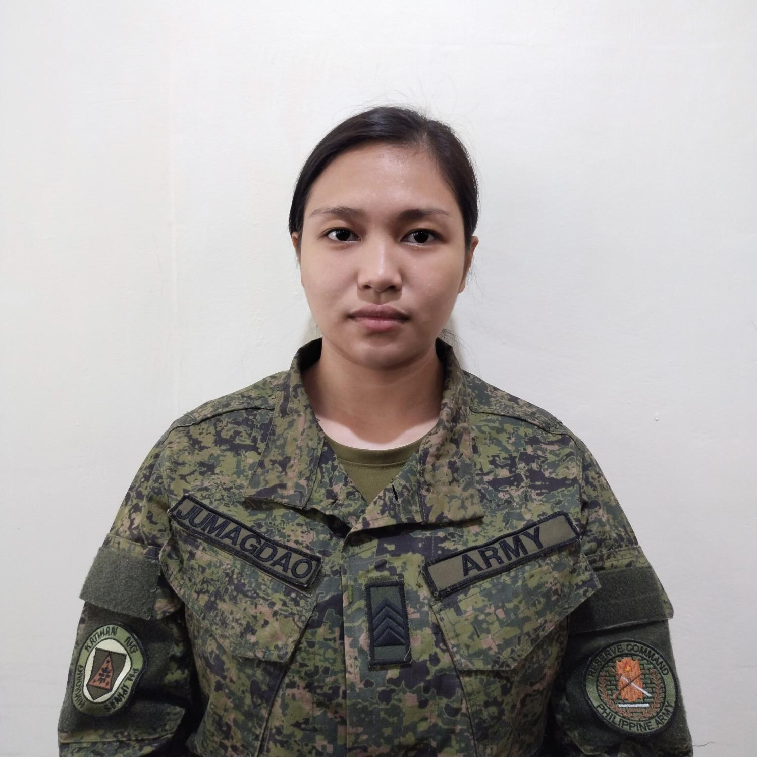
SGT JEORGHY LHYNNE A JUMAGDAO PA (RES)
DESIGNATION: S3 IT SPECIALIST/DRAFTS MAN
UNIT ASSIGNMENT: 504RRIBn, 1701RRIBde, PA
MOBILIZATION UNIT: 504CDC, 5RCDG, RESCOM, PA
GRADUATE OF BS SOCIAL WORK
LICENSURE EXAMINATION FOR SOCIAL WORKER PASSER
REGISTERED SOCIAL WORKER
DOH HEMB BLS LAY RESCUER

Slide 3


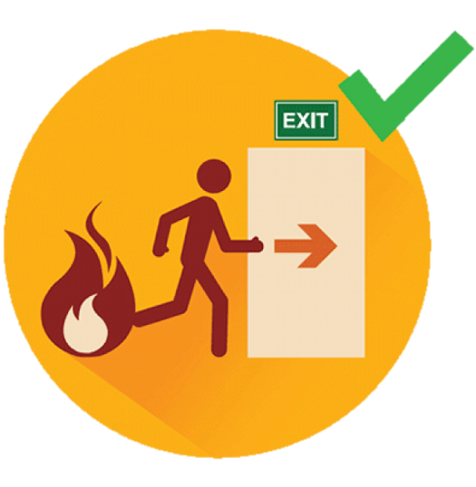
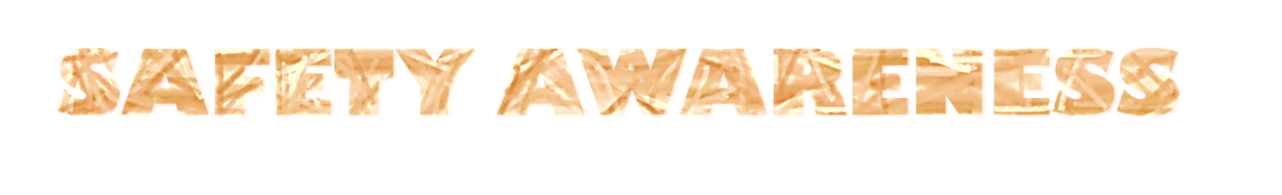
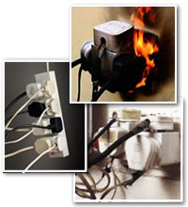


Slide 4

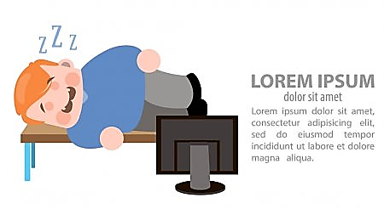
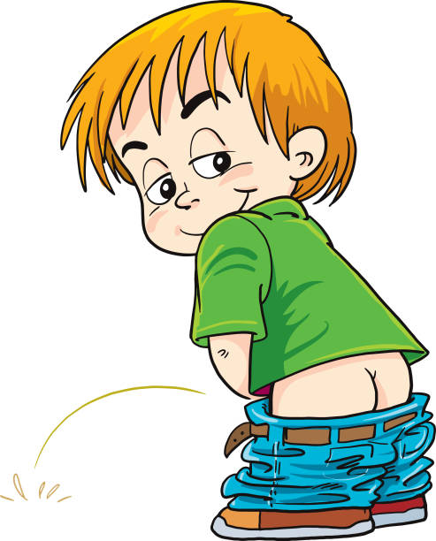
CLASSROOM RULES
Be responsible to keep yourself awake
Finds your way towards the toilet silently when you feel the urge
If there is any question, just write it down on the comment box for those who are online, for the F2F keep your question to yourself and wait to be acknowledged

Slide 5
Values Development

Slide 6
TERMINAL LEARNING OBJECTIVE
ACTION:
Discuss the topics covered by the values development
CONDITION:
Given in an online and face to face classroom environment, power-point presentation
STANDARD:
The student will;
Gain insight on what is Values Development
understand and differenciate terms used in the discussion (e.g self development and values development, ideal and percieved self etc.)

Slide 7
SCOPE OF LEARNING
SELF DEVELOPMENT
VALUES EDUCATION
FORCES THAT SHAPES CONTEMPORARY VALUES
THEORIES OF VALUES FORMATION
ETHICS AND MORAL EDUCATION
MORALITY AND OUR CONSCIENCE

Slide 8
Self Development
Is defined as a process of conciously improving oneself in various aspects of his/ her life.
It is the conscious pursuit of personal growth by improving personal skills , competencies, talents and knowledge
Notes:
i order to consciously change and develop ourselves we must begin with self awareness and self discovery which leads us to the concept of self

Slide 9
Self Concept
“The individual's belief about himself or herself, including the person's attributes and who and what the self is"- Baumeister (1999)
“is an overarching idea we have about who we are—physically, emotionally, socially, spiritually, and in terms of any other aspects that make up who we are” (Neill, 2005).

Slide 10
Self Concept
How does Self Concept develops?
through interation with others
though the stories we hear
through media

Slide 11
Self Concept
Self Concept can be changed
through our environment
through interaction

Slide 12
Self Concept
3 components of Self Concept according to Carl Rogers
Perceived Self - How person sees self & and how others see them
2. Real Self - How the person really is
3. Ideal Self - How the person would like to be
Notes:
then kung alam mo na kung ano ba yung ideal and percieved self mo then you can start on self assessment

Slide 13
Self Assessment
the act or process of analyzing and evaluating
oneself or one's actions - Webster Dictionary
helps to put any challenges into perspective
while helping the individual to identify
their strengths.- angy (2021)
Notes:
after the self assessment we can now work on setting our goals, kasi self assessment enables us to come up with our self development plan, development plan will help us focus on specific skill or competencies kaya nagiging proficient tayo. kung baga pini pwersa mo yung sarili mo na mag aquire ng kaalaman at mag organize ng resources , dahil don kaya tayo nagiging effective.

Slide 14
Social Identity
Who you are based on your membership in social
groups, such as sports teams,
religions, political parties, or social class
Refers to the ways that people’s self concepts are
based on their membership in social groups
Link individuals to reference groups, which establish a set of role expectations and norms that guide the individual’s behavior within each of the social
identities.

Slide 15
Self Esteem
How much you like, accept, and value yourself
all contribute to your self-concept.
Self-esteem can be affected by a number of
factors—including how others see you,
how you think you compare to others,
and your role in society.

Slide 16
Values
are the beliefs, which we hold to be true -
those noble ideals we struggle to attain and
implement in our daily lives..
Derived from the natural and moral laws and
not from individual’s opinions and feelings.

Slide 17
Values Education
is based on a rational understanding of the human person, specifically on understanding of the Filipino as a human being in society and his/her role in the shaping of society and the environment.

Slide 18
THEORIES OF VALUES FORMATION
Psychoanalysis Theory (Sigmund Freud)
- The core of psychoanalysis is the belief that all people possess unconscious thoughts, feelings, desires, and memories
- Suggests that people can experience catharsis and gain insight into their current state of mind by bringing the content of the unconscious into conscious awareness.

Slide 19
THEORIES OF VALUES FORMATION
Behavioral Perspective (John Watson)
- behavioral perspective suggest that the keys to understanding developing are observable behavior and outside stimuli in the environment. If we know the stimuli, we can predict the behavior.
-development depends on learning
Social Learning Theory (Albert Bandura)
-when we see the behavior of a model being rewarded, we are likely to imitate that behavior. Behavior is learned through observation and imitation, not conditioning through reinforcement or punishment.

Slide 20
THEORIES OF VALUES FORMATION
Cognitive Theory (Jean Piaget)
- suggests that the human mind is like a computer that is constantly processing and encoding data. According to cognitive theory, when a person experiences stimuli, their minds will look toward prior schema
SocioCultural Theory (Lev Vygotsky)
Sociocultural theory stresses the role that social interaction plays in psychological development. It suggests that human learning is largely a social process, and that our cognitive functions are formed based on our interactions with those around us who are "more skilled."

Slide 21
THEORIES OF VALUES FORMATION
Ecological Systems Theory (Urie Bronfenbrenner)
-This theory argues that the environment you grow up in affects every facet of your life. Social factors determine your way of thinking, the emotions you feel, and your likes and dislikes
Humanism Theory.
-The humanistic perspective contends that people have a natural tendency to make decisions about their lives and control behavior.

Slide 22
THEORIES OF VALUES FORMATION
Evolutionary Theory.
The Evolutionary Theory stresses that behavior is strongly influenced by biology, is tied to evolution, and is characterized by critical or sensitive periods (Santrock, 1999).

Slide 23
ETHICS AND MORAL EDUCATION
Ethics
-comes from the Greek word ethos, meaning character or custom.
- examines the rational justification for our moral judgments; it studies what is morally right or wrong, just or unjust. In a broader sense, ethics reflects on human beings and their interaction with nature and with other humans, on freedom, on responsibility and on justice

Slide 24
ETHICS AND MORAL EDUCATION
Morality
-refers to the set of standards that enable people to live cooperatively in groups. It’s what societies determine to be “right” and “acceptable.”
- isn’t fixed. What’s considered acceptable in your culture might not be acceptable in another culture. Geographical regions, religion, family, and life experiences all influence morals.

Slide 25
ETHICS AND MORAL EDUCATION
Morality
The term morality can be used either:
1. Descriptively to refer to a code of conduct put forward by a society and that it is used as a guide to behavior by the members of that society.
2. Normatively to refer to a code of conduct that, given specified conditions, would be put forward by alL rational persons for governing the behavior of all moral agents.

Slide 26
MORALS AND CONSCIENCE
Through our individual conscience, we become aware of our deeply held moral principles, we are motivated to act upon them, and we assess our character, our behavior and ultimately our self against those principles.
Morality affects our daily choices, and those decisions are guided by our conscience. The purpose of morality is to provide a frame work of optimum human survival.

Slide 27
REFERENCES
Ackerman, C. E., MA. (2022, July 7). What is Self-Concept Theory? A Psychologist Explains. PositivePsychology.com. Retrieved October 1, 2022, from https://positivepsychology.com/self-concept/
Just a moment. . . (n.d.). Retrieved October 1, 2022, from https://www.sciencedirect.com/topics/psychology/social-identity-theory#:%7E:text=Social%20identity%20refers%20to%20the,%2C%20ethnic%20groups%2C%20and%20gender.
Kurtz, F. (2012, March 6). GRIN - Self development - Definitions, Process, Methods. Retrieved October 1, 2022, from https://www.grin.com/document/190316
McLeod, S. A. (2014, Febuary 05). Carl Rogers. Simply Psychology. www.simplypsychology.org/carl-rogers.html
N., Sam M.S., "SELF-DEVELOPMENT," in PsychologyDictionary.org, April 13, 2013,
https://psychologydictionary.org/self-development/ (accessed September 30, 2022).
self-assessment. (n.d.). In The Merriam-Webster.com Dictionary. Retrieved October 1, 2022, from https://www.merriam-webster.com/dictionary/self-assessment
What Is Self-Concept and How Does It Form? (2022, September 13). Verywell Mind. Retrieved October 1, 2022, from https://www.verywellmind.com/what-is-self-concept-2795865
What is Social Ecology? - Issues in Social Work. (2022, April 20). CORP-MSW1 (OMSWP). Retrieved October 1, 2022, from https://www.onlinemswprograms.com/social-work/what-is-social-ecology/#:%7E:text=The%20ecological%20systems%20theory%20in,them%20into%20who%20they%20are.
You Asked: Why is Self Assessment Important in Social Work? | Social Work Haven. (2021, January 25). Social Work Haven | Become a Social Worker. Become a Better You. Retrieved October 1, 2022, from https://socialworkhaven.com/you-asked-why-is-self-assessment-important-in-social-work/#:%7E:text=Self%2Dassessment%20provides%20social%20workers,learning%20needs%20for%20personal%20development.

Slide 28
REFERENCES
How Psychoanalysis Influenced the Field of Psychology. (2020, October 6). Verywell Mind. Retrieved October 1, 2022, from https://www.verywellmind.com/what-is-psychoanalysis-2795246#:%7E:text=Psychoanalysis%20is%20defined%20as%20a,feelings%2C%20desires%2C%20and%20memories.
Why Behaviorism Is One of Psychology’s Most Fascinating Branches. (2022, September 15). Verywell Mind. Retrieved October 1, 2022, from https://www.verywellmind.com/behavioral-psychology-4157183
Study.com | Take Online Courses. Earn College Credit. Research Schools, Degrees & Careers. (n.d.). Retrieved October 2, 2022, from https://study.com/learn/lesson/cognitive-theory.html#:%7E:text=Cognitive%20theory%20suggests%20that%20the,help%20them%20understand%20this%20information.
Mcleod, S. (2022, May 5). Vygotsky - Social Development Theory. Retrieved October 2, 2022, from https://www.simplypsychology.org/vygotsky.html#:%7E:text=Vygotsky’s%20sociocultural%20theory%20views%20human,more%20knowledgeable%20members%20of%20society.
Santa Clara University. (n.d.). Theoretical Framework - Office for Multicultural Learning - Santa Clara University. Retrieved October 2, 2022, from https://www.scu.edu/oml/about-us/theoretical-framework/
Secretariat, T. B. O. C. (n.d.). What is ethics? - Canada.ca. Retrieved October 2, 2022, from https://www.canada.ca/en/treasury-board-secretariat/services/values-ethics/code/what-is-ethics.html
What’s the Difference Between Morality and Ethics? (n.d.). Encyclopedia Britannica. Retrieved October 2, 2022, from https://www.britannica.com/story/whats-the-difference-between-morality-and-ethics

Slide 29
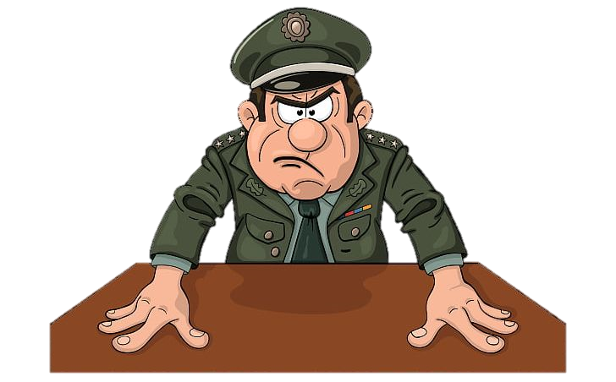
Any Question?

Slide 30
CHECK ON LEARNING
What is Self Development?
What are the 3 Self Concepts by Carl Rogers/
Give 3 Theories on Values Development
What is the difference between Morality and Ethics?

Slide 31


